Slide 1
Image Stitching
Huỳnh Anh Duy
Nguyễn Bảo Phước
Nguyễn Cảnh Toàn
Trịnh Ngọc Nghĩa
Dương Minh Đức

Slide 2
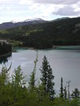
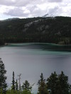
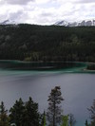
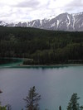
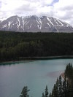
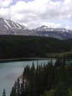
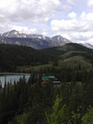
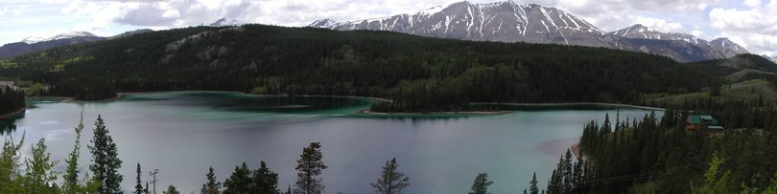
Overview
Combine two or more overlapping images to make one larger image

Slide 3

Why Panoramas?
Getting the whole picture
Consumer camera: 50˚ x 35˚
[Brown 2003]

Slide 4
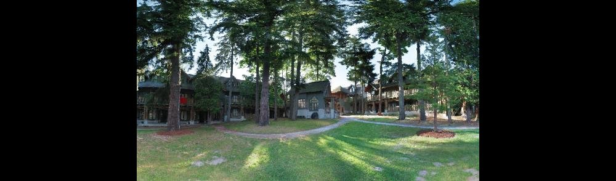
Why Panoramas?
Getting the whole picture
Consumer camera: 50˚ x 35˚
Human Vision: 176˚ x 135˚
[Brown 2003]

Slide 5
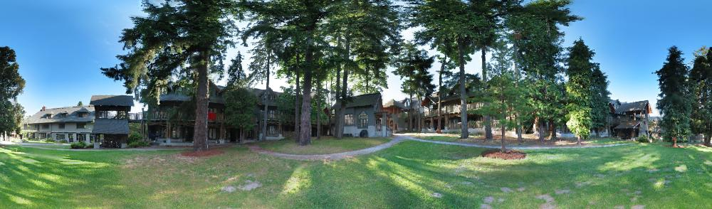
Why Panoramas?
Getting the whole picture
Consumer camera: 50˚ x 35˚
Human Vision: 176˚ x 135˚
Panoramic mosaics: up to 360˚ x 180˚
[Brown 2003]

Slide 6
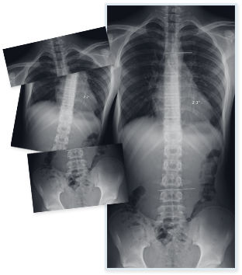
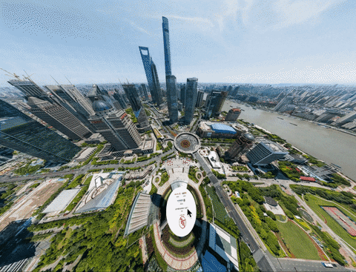
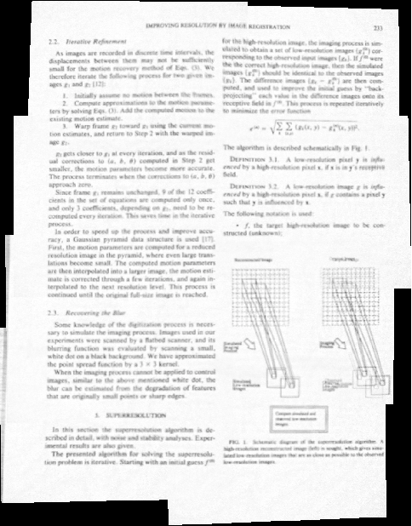
Application
Document mosaicing
Medical Imaging
Super Resolution Image

Slide 7
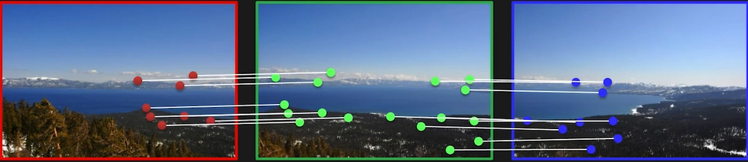
Overview
Image 1
Image 2
Image 3
Find corresponding points
(using feature detectors like SIFT)

Slide 8
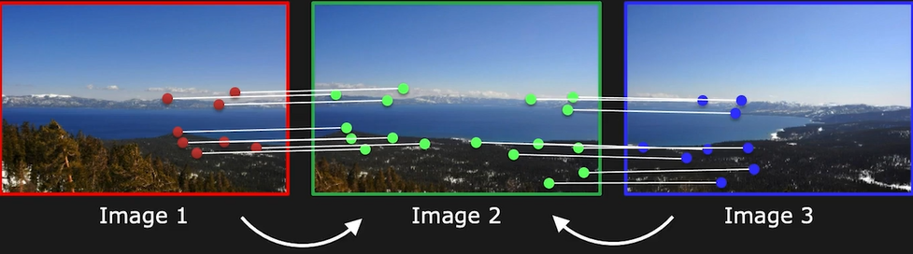
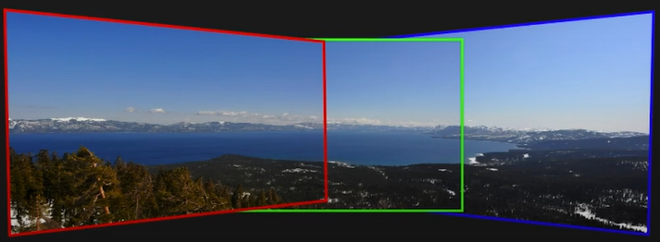
Overview
Find geometric relationship between the images
Warp images so that corresponding points align

Slide 9
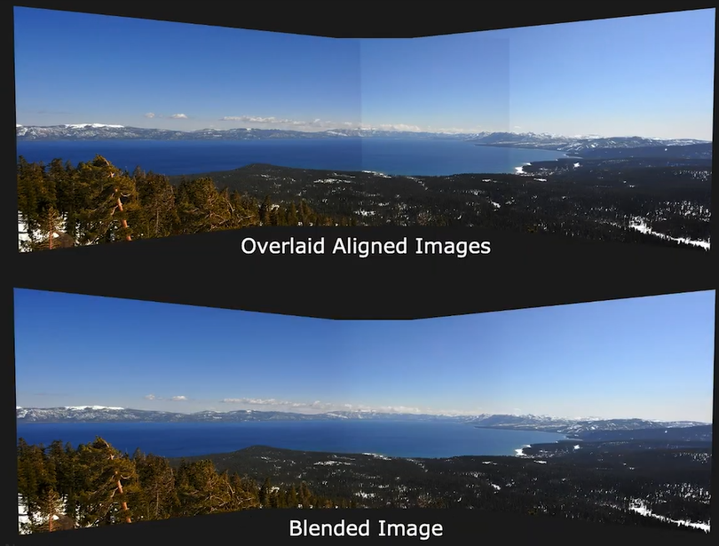
Overview
Blend images to remove hard seams

Slide 10
Topics
Image Transformation
Key points detection
Computing Homography
Dealing with Outliers: RANSAC
Warping and Blending images

Slide 11
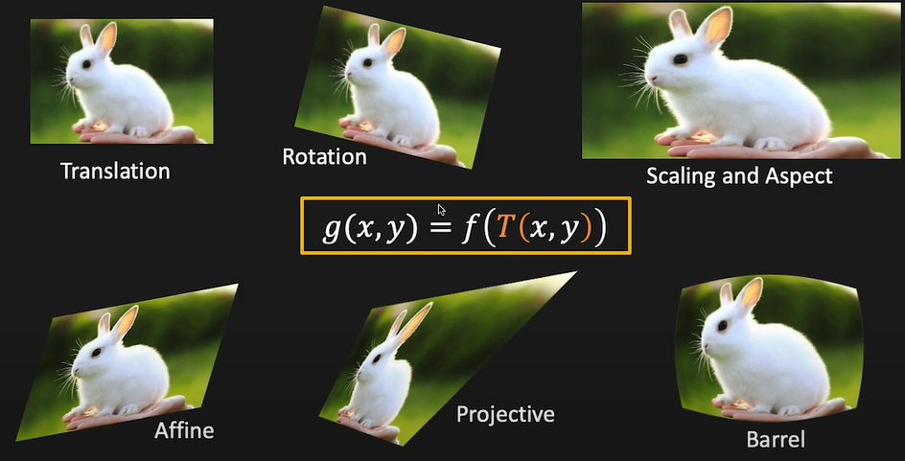
Image Transformation
2x2 Image Transformation

Slide 12
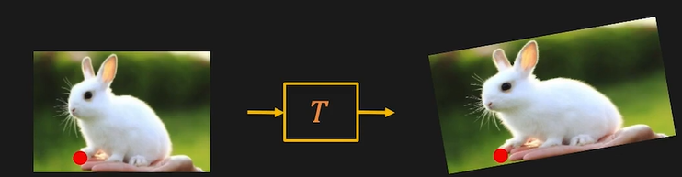





Image Transformation
2x2 Image Transformation
$$p_{1}=(x_{1}, y_{1})$$
$$p_{2}=(x_{2}, y_{2})$$
T can be represented by a matrix
$$\left[{x_{2} \atop y_{2}}\right]=T\left[{x_{1} \atop y_{1}}\right]$$
$$\left[{x_{2} \atop y_{2}}\right]=\left[{a_{11} \atop a_{21}}{a_{12} \atop a_{22}}\right]\left[{x_{1} \atop y_{1}}\right]$$
$$p_{2}=Tp_{1}$$

Slide 13
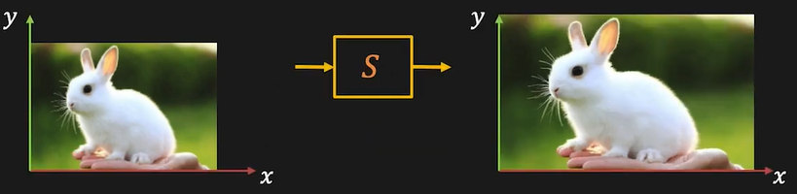


Image Transformation
Scaling (Stretching or Squishing)
Forward:
$$x_{2}=ax_{1} y_{2}=by_{1}$$
$\left[{x_{2} \atop y_{2}}\right]=S\left[{x_{1} \atop y_{1}}\right]=\left[\begin{matrix}a & 0 \\ 0 & b\end{matrix}\right]\left[\begin{matrix}x_{1} \\ y_{1}\end{matrix}\right]$
Inverse:
$$x_{1}=\frac{1}{a}x_{2} y_{1}=\frac{1}{b}y_{2}$$
$\left[{x_{1} \atop y_{1}}\right]=S^{−1}\left[{x_{2} \atop y_{2}}\right]=\left[\begin{matrix}1/a & 0 \\ 0 & 1/b\end{matrix}\right]\left[\begin{matrix}x_{2} \\ y_{2}\end{matrix}\right]$

Slide 14
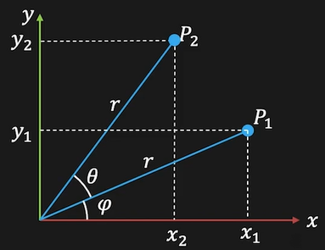



Image Transformation
2D Rotation
$$x_{1}=r\cos{φ}$$
$$y_{1}=r\sin{φ}$$
$$x_{2}=r\cos{(φ+θ)}$$
$x_{2}=r\cos{φ \cos{θ}−r\sin{φ}\sin{θ}}$
$$x_{2}=x_{1}\cos{θ}−y_{1}\sin{θ}$$
$$y_{2}=r\cos{(φ+θ)}$$
$y_{2}=r\cos{φ \sin{θ}+r\sin{φ}\cos{θ}}$
$$y_{2}=x_{1}\sin{θ}+y_{1}\cos{θ}$$

Slide 15
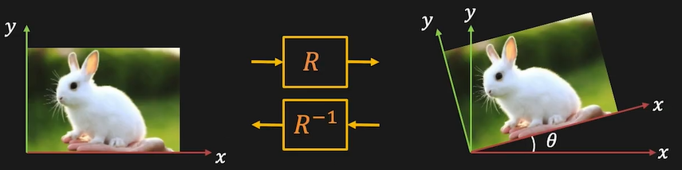


Image Transformation
Rotation
Forward:
$$x_{2}=x_{1}\cos{θ−y_{1}\sin{θ}}$$
$y_{2}=x_{1}\sin{θ+y_{1}\cos{θ}}$
$$\left[\begin{matrix}x_{2} \\ y_{2}\end{matrix}\right]=R\left[\begin{matrix}x_{1} \\ y_{1}\end{matrix}\right]=\left[\begin{matrix}\cos{θ} & −\sin{θ} \\ \sin{θ} & \cos{θ}\end{matrix}\right]\left[\begin{matrix}x_{1} \\ y_{1}\end{matrix}\right]$$
Inverse:
$$x_{1}=x_{2}\cos{θ+y_{2}\sin{θ}}$$
$y_{1}={−x}_{2}\sin{θ+y_{2}\cos{θ}}$
$$\left[\begin{matrix}x_{1} \\ y_{1}\end{matrix}\right]=R^{−1}\left[\begin{matrix}x_{2} \\ y_{2}\end{matrix}\right]=\left[\begin{matrix}\cos{θ} & \sin{θ} \\ −\sin{θ} & \cos{θ}\end{matrix}\right]\left[\begin{matrix}x_{2} \\ y_{2}\end{matrix}\right]$$

Slide 16
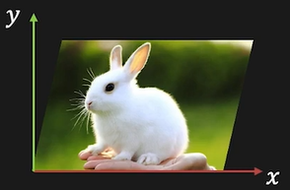
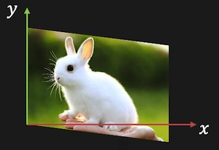


Image Transformation
Skew
Horizontal Skew:
$$x_{2}=x_{1}+m_{x}y_{1}$$
$y_{2}=y_{1}$
$$\left[\begin{matrix}x_{2} \\ y_{2}\end{matrix}\right]=S_{x}\left[\begin{matrix}x_{1} \\ y_{1}\end{matrix}\right]=\left[\begin{matrix}1 & m_{x} \\ 0 & 1\end{matrix}\right]\left[\begin{matrix}x_{1} \\ y_{1}\end{matrix}\right]$$
Vertical Skew:
$$x_{2}=x_{1}$$
$y_{2}=m_{y}x_{1}+y_{1}$
$$\left[\begin{matrix}x_{2} \\ y_{2}\end{matrix}\right]=S_{x}\left[\begin{matrix}x_{1} \\ y_{1}\end{matrix}\right]=\left[\begin{matrix}1 & 0 \\ m_{y} & 1\end{matrix}\right]\left[\begin{matrix}x_{1} \\ y_{1}\end{matrix}\right]$$

Slide 17
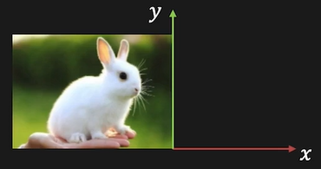
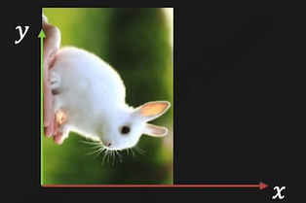


Image Transformation
Mirror
Mirror about Y-axis:
$$x_{2}={−x}_{1}$$
$y_{2}=y_{1}$
$$M_{y}=\left[\begin{matrix}−1 & 0 \\ 0 & 1\end{matrix}\right]$$
Mirror about line $y=x$:
$$x_{2}=y_{1}$$
$y_{2}=x_{1}$
$$M_{xy}=\left[\begin{matrix}0 & 1 \\ 1 & 0\end{matrix}\right]$$

Slide 18

Image Transformation
2x2 Image Transformation
Any transformation of the form:
$$\left[{x_{2} \atop y_{2}}\right]=\left[{a_{11} \atop a_{21}}{a_{12} \atop a_{22}}\right]\left[{x_{1} \atop y_{1}}\right]$$
Origin maps to the origin
Lines map to lines
Parallel lines remain parallel
Closed under composition

Slide 19
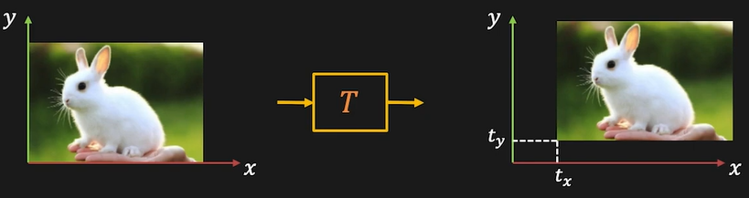


Image Transformation
3x3 Image Transformation
$$x_{2}=x_{1}+t_{x}$$
$$y_{2}=y_{1}+t_{y}$$
Can this translation be expressed as a 2x2 matrix ? No

Slide 20
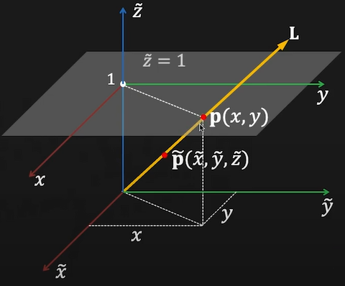



Image Transformation
3x3 Image Transformation
The homogenous representation of a 2D point $p=(x,y)$ is a 3D point$\tilde{p}=\left(\tilde{x}, \tilde{y}, \tilde{z}\right).$ The third coordinate $\tilde{z}≠0$ is fictitious such that:
$$x=\frac{\tilde{x}}{\tilde{z}} y=\frac{\tilde{y}}{\tilde{z}}$$
$$p≡\left[\begin{matrix}x \\ y \\ 1\end{matrix}\right]≡\left[\begin{matrix}\tilde{z}x \\ \tilde{z}y \\ \tilde{z}\end{matrix}\right]≡\left[\begin{matrix}\tilde{x} \\ \tilde{y} \\ \tilde{z}\end{matrix}\right]≡\tilde{p}$$
Every point on line L (except origin) represents the homogeneous coordinate of $p(x,y)$

Slide 21




Image Transformation
3x3 Image Transformation
$$\left[\begin{matrix}{\tilde{x}}_{2} \\ {\tilde{y}}_{2} \\ {\tilde{z}}_{2}\end{matrix}\right]=\left[\begin{matrix}s_{x} & 0 & 0 \\ 0 & s_{y} & 0 \\ 0 & 0 & 1\end{matrix}\right]\left[\begin{matrix}x_{1} \\ y_{1} \\ 1\end{matrix}\right]$$
$$\left[\begin{matrix}{\tilde{x}}_{2} \\ {\tilde{y}}_{2} \\ {\tilde{z}}_{2}\end{matrix}\right]=\left[\begin{matrix}1 & m_{x} & 0 \\ 0 & 1 & 0 \\ 0 & 0 & 1\end{matrix}\right]\left[\begin{matrix}x_{1} \\ y_{1} \\ 1\end{matrix}\right]$$
Scaling
Skew
$$\left[\begin{matrix}{\tilde{x}}_{2} \\ {\tilde{y}}_{2} \\ {\tilde{z}}_{2}\end{matrix}\right]=\left[\begin{matrix}1 & 0 & t_{x} \\ 0 & 1 & t_{y} \\ 0 & 0 & 1\end{matrix}\right]\left[\begin{matrix}x_{1} \\ y_{1} \\ 1\end{matrix}\right]$$
$$\left[\begin{matrix}{\tilde{x}}_{2} \\ {\tilde{y}}_{2} \\ {\tilde{z}}_{2}\end{matrix}\right]=\left[\begin{matrix}\cos{θ} & −sin{θ} & 0 \\ \sin{θ} & \cos{θ} & 0 \\ 0 & 0 & 1\end{matrix}\right]\left[\begin{matrix}x_{1} \\ y_{1} \\ 1\end{matrix}\right]$$
Translation
Rotation

Slide 22
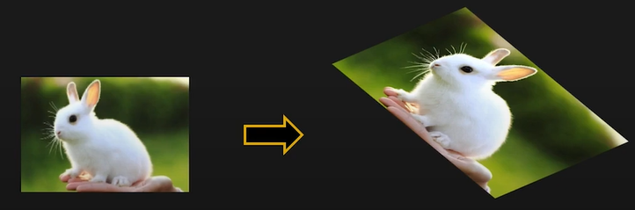

Image Transformation
3x3 Image Transformation
Affine Transformation
Any transformation of the form:
$$\left[\begin{matrix}x_{2} \\ y_{2} \\ 1\end{matrix}\right]≡\left[\begin{matrix}{\tilde{x}}_{2} \\ {\tilde{y}}_{2} \\ {\tilde{z}}_{2}\end{matrix}\right]=\left[\begin{matrix}a_{11} & a_{12} & a_{13} \\ a_{21} & a_{22} & a_{23} \\ 0 & 0 & 1\end{matrix}\right]\left[\begin{matrix}{\tilde{x}}_{1} \\ {\tilde{y}}_{1} \\ {\tilde{z}}_{1}\end{matrix}\right]$$
Origin does not necessarily map to the origin
Lines map to the lines
Parallel lines remain parallel
Closed under composition

Slide 23
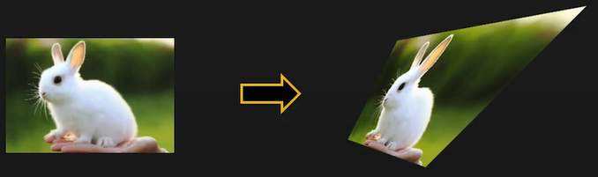


Image Transformation
3x3 Image Transformation
Projective Transformation
Any transformation of the form:
$$\left[\begin{matrix}x_{2} \\ y_{2} \\ 1\end{matrix}\right]≡\left[\begin{matrix}{\tilde{x}}_{2} \\ {\tilde{y}}_{2} \\ {\tilde{z}}_{2}\end{matrix}\right]=\left[\begin{matrix}h_{11} & h_{12} & h_{13} \\ h_{21} & h_{22} & h_{23} \\ h_{31} & h_{32} & h_{33}\end{matrix}\right]\left[\begin{matrix}{\tilde{x}}_{1} \\ {\tilde{y}}_{1} \\ {\tilde{z}}_{1}\end{matrix}\right]$$
$${\tilde{p}}_{2}=H{\tilde{p}}_{1}$$
Also called Homography

Slide 24
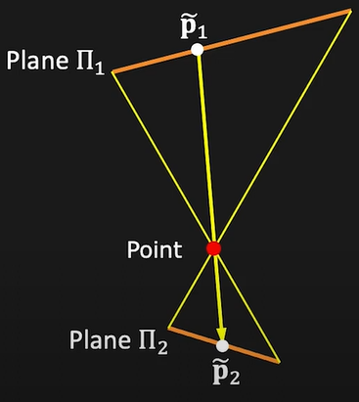


Image Transformation
3x3 Image Transformation
Projective Transformation
$${\tilde{p}}_{2}=H{\tilde{p}}_{1}$$
$$\left[\begin{matrix}{\tilde{x}}_{2} \\ {\tilde{y}}_{2} \\ {\tilde{z}}_{2}\end{matrix}\right]=\left[\begin{matrix}h_{11} & h_{12} & h_{13} \\ h_{21} & h_{22} & h_{23} \\ h_{31} & h_{32} & h_{33}\end{matrix}\right]\left[\begin{matrix}{\tilde{x}}_{1} \\ {\tilde{y}}_{1} \\ {\tilde{z}}_{1}\end{matrix}\right]$$
Same as imaging a plane through a pinhole

Slide 25


Image Transformation
3x3 Image Transformation
Projective Transformation
Homography can only be defined up to a scale
$$\left[\begin{matrix}h_{11} & h_{12} & h_{13} \\ h_{21} & h_{22} & h_{23} \\ h_{31} & h_{32} & h_{33}\end{matrix}\right]\left[\begin{matrix}{\tilde{x}}_{1} \\ {\tilde{y}}_{1} \\ {\tilde{z}}_{1}\end{matrix}\right]≡\left[\begin{matrix}{\tilde{x}}_{2} \\ {\tilde{y}}_{2} \\ {\tilde{z}}_{2}\end{matrix}\right]≡k\left[\begin{matrix}h_{11} & h_{12} & h_{13} \\ h_{21} & h_{22} & h_{23} \\ h_{31} & h_{32} & h_{33}\end{matrix}\right]\left[\begin{matrix}{\tilde{x}}_{1} \\ {\tilde{y}}_{1} \\ {\tilde{z}}_{1}\end{matrix}\right]$$
If we fix scale such that $\sqrt{\sum{{(h_{ij})}^{2}}}=1$ then 8 free parameters
Origin does not necessarily map to the origin
Lines map to lines
Parallel lines do not necessarily remain parallel
Closed under composition

Slide 26
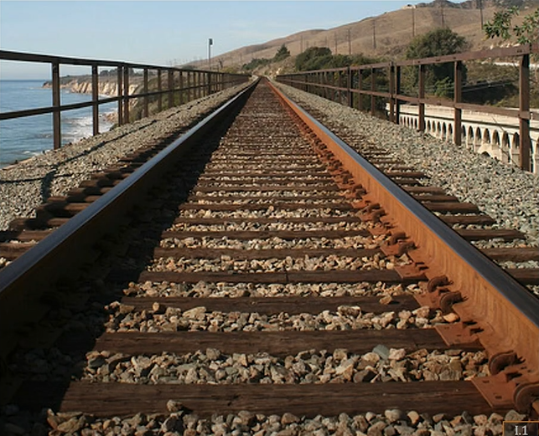
Image Transformation
3x3 Image Transformation
Projective Transformation

Slide 27
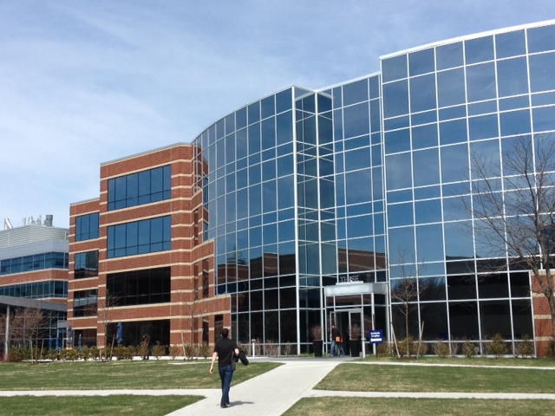
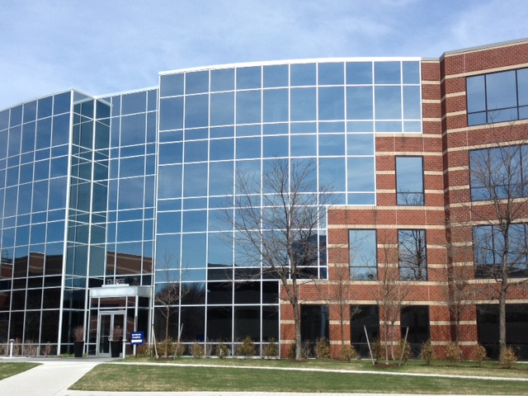
SIFT - Introduce
Question: How can we find matching point between images?

Slide 28
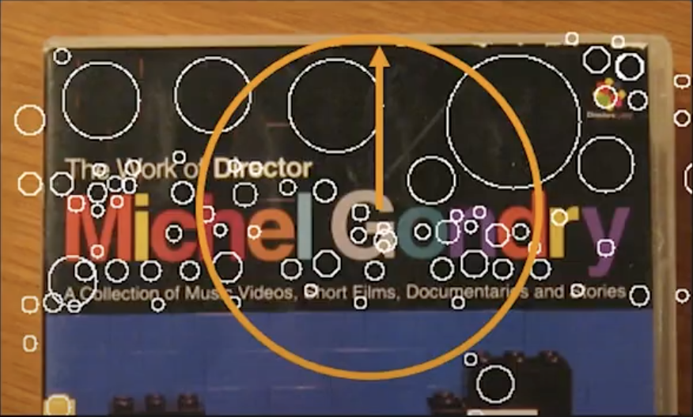
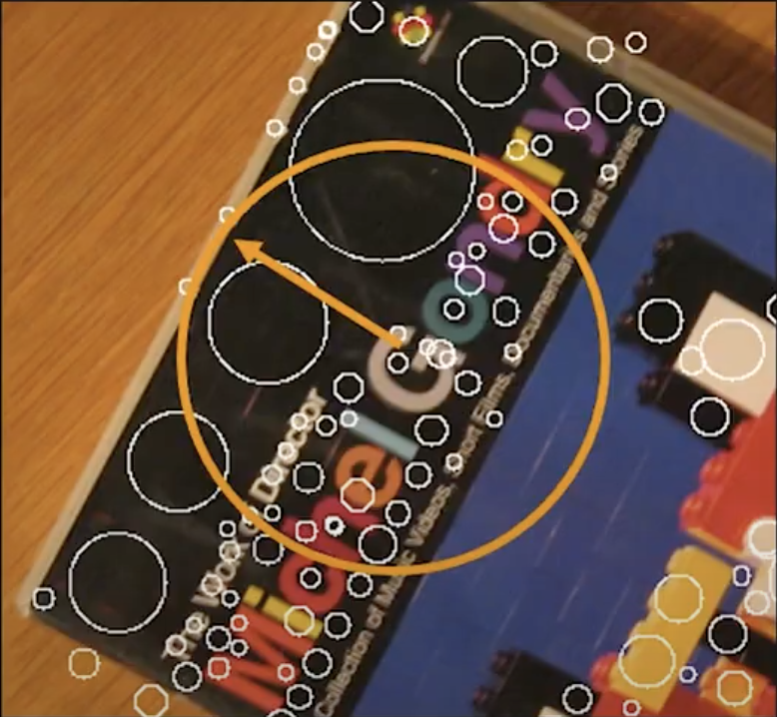
SIFT - Introduce
Scale-Invariant Feature Transform (SIFT) is an algorithm in the field of Computer Vision, which used to identify and describe local features in images.
One of the advantages of SIFT is that it is scale-invariant, i.e., it can give a stable result with different image scale.

Slide 29
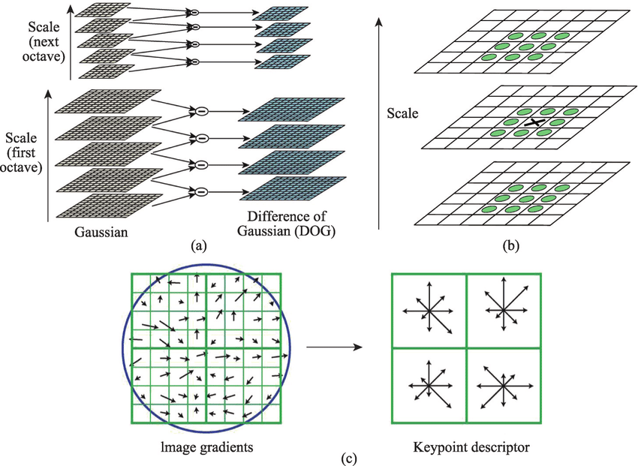
SIFT - Introduce
3 main steps:
Compute Difference of Gaussian (DoG)
Keypoint detection
Keypoint descriptor

Slide 30
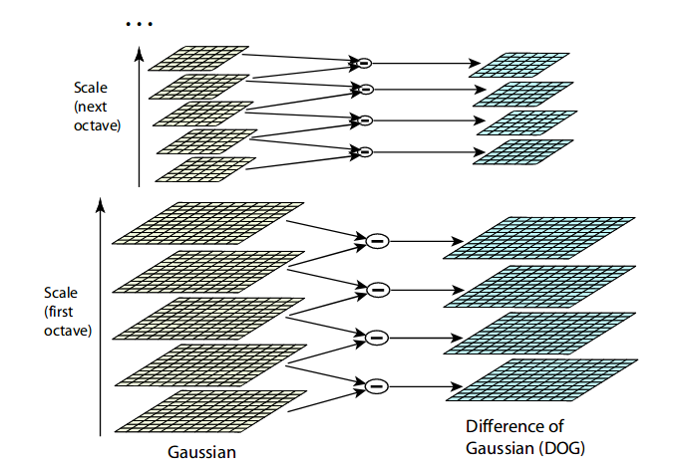
SIFT – Compute DoG
This approximates Laplacian of Gaussian (which usually use as some sort of feature detector)

Slide 31
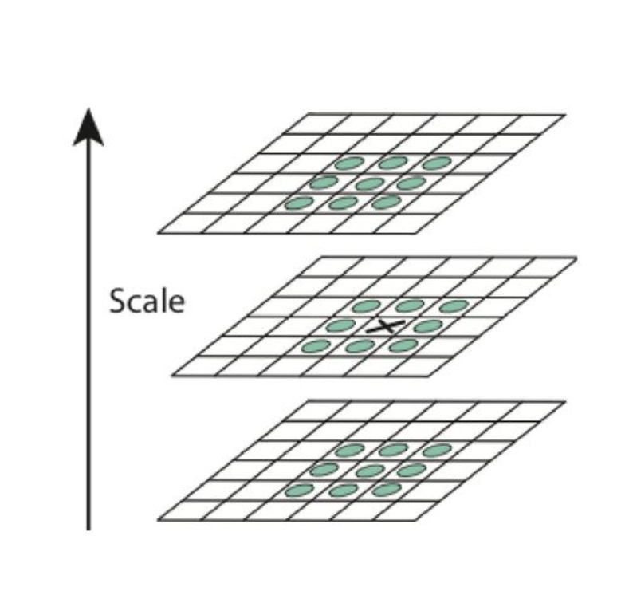

SIFT – Scale-space Extremum
Each pixel is compares to its 26 pixels in 3x3 region at the current and adjacent scales (marked with circles)
For more accuracy ➔ Interpolation using Taylor expansion:
$D\left(x\right)=D+ \frac{∂D^{T}}{∂x}x+\frac{1}{2}x^{T}\frac{∂^{2}D^{T}}{∂x^{2}}x$
Take derivation and set to zero:
$\hat{x}=−\frac{∂^{2}D^{−1}}{∂x^{2}}$ $\frac{∂D}{∂x}$

Slide 32

SIFT – Accurate keypoint localization
Low contrast: Discard keypoints with $D\left(\hat{x}\right)$ < threshold
Edge points: Discard using eigenvalue of hessian matrix:
$$H= \left[\begin{matrix}Dxx & Dxy \\ Dxy & Dyy\end{matrix}\right]$$
$$Tr\left(H\right)=Dxx+Dxy= α+β$$
$$Det\left(H\right)=DxxDyy −{\left(Dxy\right)}^{2}=αβ$$
Assume $α=rβ$: $\frac{{Tr\left(H\right)}^{2}}{Det(H)}= \frac{{(r+1)}^{2}}{r}$

Slide 33
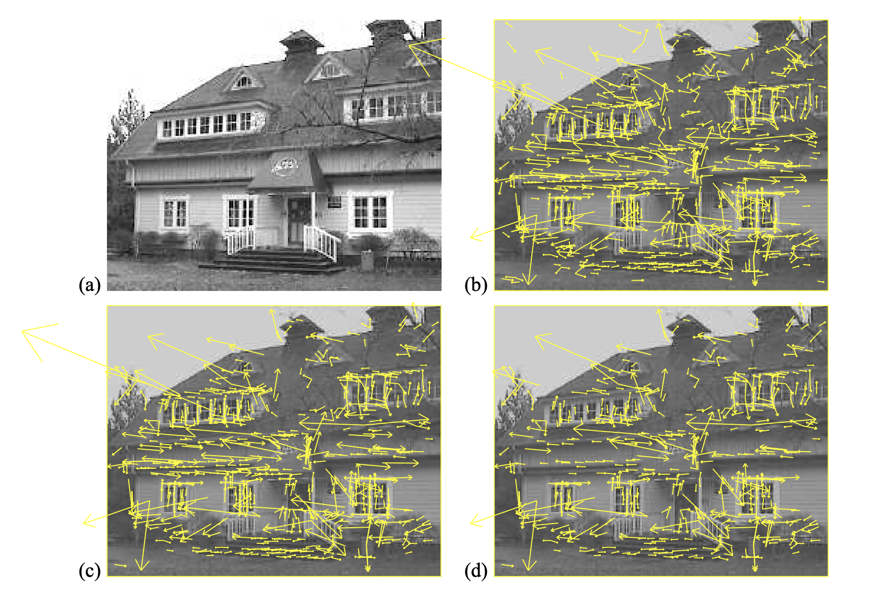
SIFT – Accurate keypoint localization

Slide 34

SIFT – Feature description
Keypoints orientation:
For each neighborhood pixel (within certain radius (default 3) and scale (default 1.5)), compute gradient magnitude(m) and orientation($θ)$:
$$m\left(x,y\right)= \sqrt{{(L\left(x+1,y\right)−L\left(x−1,y\right))}^{2}+ {(L\left(x, y+1\right)−L\left(x,y−1\right))}^{2}}$$
$$θ\left(x, y\right)= \tan^{−1}{(\frac{L\left(x,y+1\right)−L\left(x,y−1\right)}{L\left(x+1,y\right)−L\left(x−1, y\right)})}$$
Assign all orientation to 36 bins histogram that cover 360 degrees orientation
Assign orientation of keypoint to the peak of histogram

Slide 35
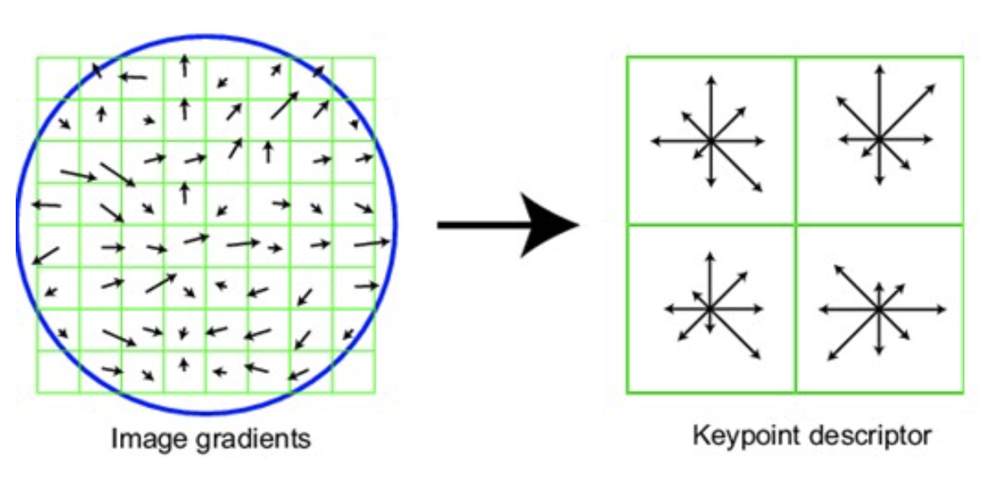
SIFT – Feature description
Divide 16x16 region surrounding keypoint into 4x4 windows
For each window, compute histogram with 8 bins cover 360 degrees of orientation
Total 4x4x8=128 feature for each keypoint

Slide 36
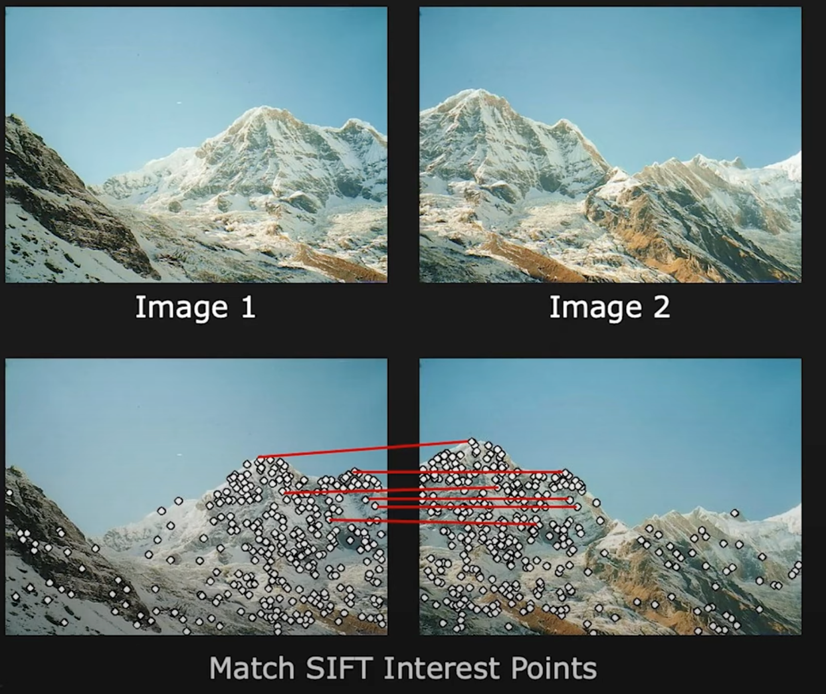
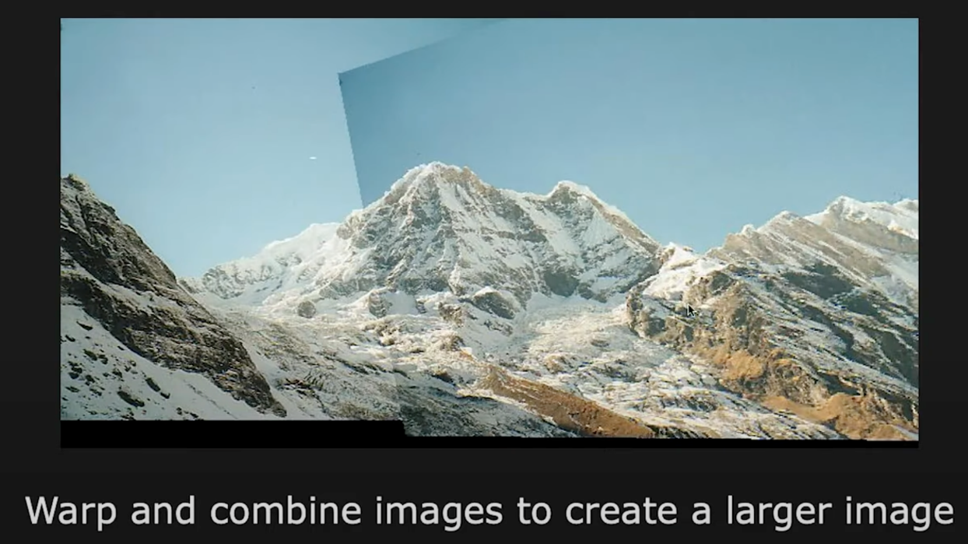
SIFT in Image stitching

Slide 37
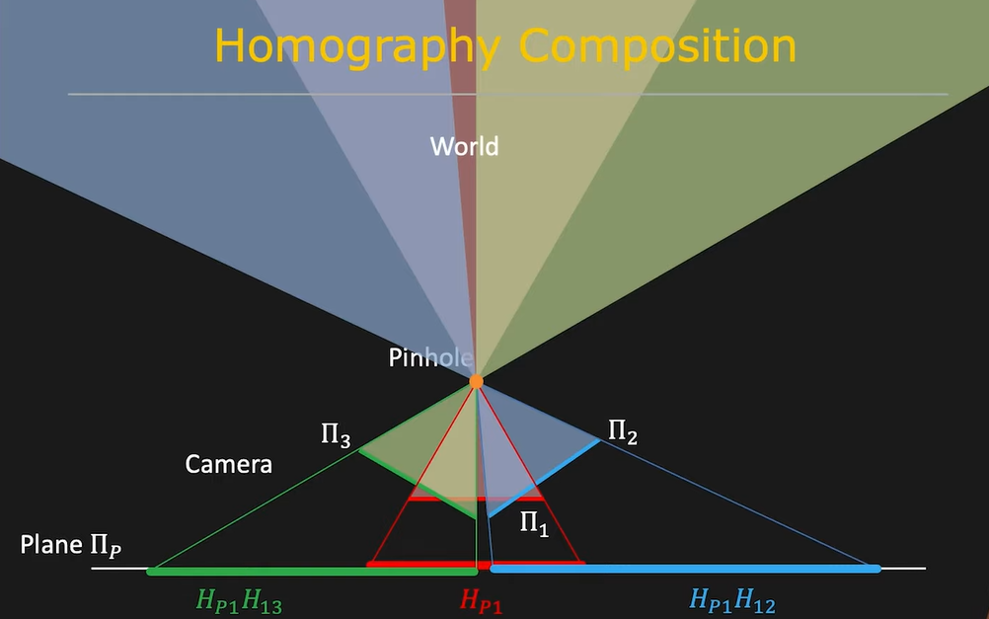
Computing homography
Useful in stitching planar panoramas

Slide 38
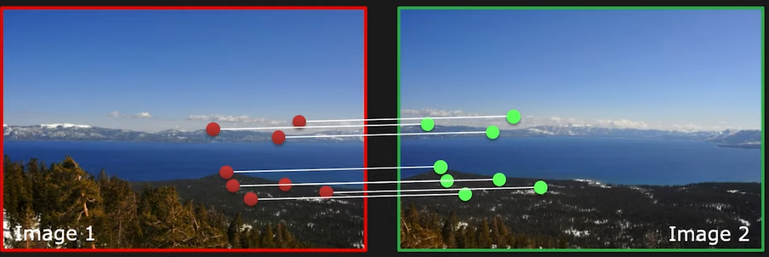
Computing homography
Given a set of matching features/points between images 1 and 2, find the homography H that best “agrees” with the matches.
The scene points should lie on a plane, or be distant (plane at infinity), or imaged from the same point

Slide 39

Computing homography
$$\left[\begin{matrix}x_{d} \\ y_{d} \\ 1\end{matrix}\right]≡\left[\begin{matrix}{\tilde{x}}_{d} \\ {\tilde{y}}_{d} \\ {\tilde{z}}_{d}\end{matrix}\right]=\left[\begin{matrix}h_{11} & h_{12} & h_{13} \\ h_{21} & h_{22} & h_{23} \\ h_{31} & h_{32} & h_{33}\end{matrix}\right]\left[\begin{matrix}{\tilde{x}}_{s} \\ {\tilde{y}}_{s} \\ 1\end{matrix}\right]$$
How many unknowns ? 9 … but 8 degrees of freedom
How many minimum pairs of matching points ? 4

Slide 40


Computing homography
For a given pair i of corresponding points:
${x_{d}}^{(i)}=\frac{{{\tilde{x}}_{d}}^{(i)}}{{{\tilde{z}}_{d}}^{(i)}}=\frac{h_{11}{x_{s}}^{(i)}+h_{12}{y_{s}}^{(i)}+h_{13}}{h_{31}{x_{s}}^{(i)}+h_{32}{y_{s}}^{(i)}+h_{33}}$
${y_{d}}^{(i)}=\frac{{{\tilde{y}}_{d}}^{(i)}}{{{\tilde{z}}_{d}}^{(i)}}=\frac{h_{21}{x_{s}}^{(i)}+h_{12}{y_{s}}^{(i)}+h_{23}}{h_{31}{x_{s}}^{(i)}+h_{32}{y_{s}}^{(i)}+h_{33}}$
Rearranging the terms:
$${x_{d}}^{\left(i\right)}\left(h_{31}{x_{s}}^{\left(i\right)}+h_{32}{y_{s}}^{\left(i\right)}+h_{33}\right)=h_{11}{x_{s}}^{(i)}+h_{12}{y_{s}}^{(i)}+h_{13}$$
$${y_{d}}^{\left(i\right)}\left(h_{31}{x_{s}}^{\left(i\right)}+h_{32}{y_{s}}^{\left(i\right)}+h_{33}\right)=h_{21}{x_{s}}^{(i)}+h_{12}{y_{s}}^{(i)}+h_{23}$$

Slide 41


Computing homography
$${x_{d}}^{\left(i\right)}\left(h_{31}{x_{s}}^{\left(i\right)}+h_{32}{y_{s}}^{\left(i\right)}+h_{33}\right)=h_{11}{x_{s}}^{(i)}+h_{12}{y_{s}}^{(i)}+h_{13}$$
$${y_{d}}^{\left(i\right)}\left(h_{31}{x_{s}}^{\left(i\right)}+h_{32}{y_{s}}^{\left(i\right)}+h_{33}\right)=h_{21}{x_{s}}^{(i)}+h_{12}{y_{s}}^{(i)}+h_{23}$$
$$\left[\begin{matrix}{x_{s}}^{\left(i\right)} \\ 0\end{matrix} \begin{matrix}{y_{s}}^{\left(i\right)} \\ 0\end{matrix} \begin{matrix}1 \\ 0\end{matrix} \begin{matrix}0 \\ {x_{s}}^{\left(i\right)}\end{matrix} \begin{matrix}0 \\ {y_{s}}^{\left(i\right) }\end{matrix}\begin{matrix}0 \\ 1\end{matrix} \begin{matrix}{{{{−x}_{d}}^{\left(i\right)}x}_{s}}^{\left(i\right)} \\ {{{{−y}_{d}}^{\left(i\right)}x}_{s}}^{\left(i\right)}\end{matrix} \begin{matrix}{{{{−x}_{d}}^{\left(i\right)}y}_{s}}^{\left(i\right)} \\ {{{{−y}_{d}}^{\left(i\right)}y}_{s}}^{\left(i\right)}\end{matrix} \begin{matrix}{{−x}_{d}}^{\left(i\right)} \\ {{−y}_{d}}^{\left(i\right)}\end{matrix}\right]\left[\begin{matrix}h_{11} \\ \begin{matrix}h_{12} \\ \begin{matrix}h_{13} \\ h_{21} \\ \begin{matrix}h_{22} \\ h_{23} \\ \begin{matrix}h_{31} \\ h_{32} \\ h_{3}\end{matrix}\end{matrix}\end{matrix}\end{matrix}\end{matrix}\right]=\left[\begin{matrix}0 \\ 0\end{matrix}\right]$$
Rearranging the terms and writing as linear equation:
(Known)
(Unknown)

Slide 42


Computing homography
Combining the equations for all corresponding points:
$$\left[\begin{matrix}x_{s}^{\left(1\right)} & y_{s}^{\left(1\right)} & 1 & 0 & 0 & 0 & −x_{d}^{\left(1\right)}x_{s}^{\left(1\right)} & −x_{d}^{\left(1\right)}x_{s}^{\left(1\right)} & −x_{d}^{\left(1\right)} \\ 0 & 0 & 0 & x_{s}^{\left(1\right)} & y_{s}^{\left(1\right)} & 1 & −y_{d}^{\left(1\right)}x_{s}^{\left(1\right)} & −y_{d}^{\left(1\right)}x_{s}^{\left(1\right)} & −y_{d}^{\left(1\right)} \\ ⋮ & ⋮ & ⋮ & ⋮ & ⋮ & ⋮ & ⋮ & ⋮ & ⋮ \\ x_{s}^{\left(i\right)} & y_{s}^{\left(i\right)} & 1 & 0 & 0 & 0 & −x_{d}^{\left(i\right)}x_{s}^{\left(i\right)} & −x_{d}^{\left(i\right)}x_{s}^{\left(i\right)} & −x_{d}^{\left(i\right)} \\ 0 & 0 & 0 & x_{s}^{\left(i\right)} & y_{s}^{\left(i\right)} & 1 & −y_{d}^{\left(i\right)}x_{s}^{\left(i\right)} & −y_{d}^{\left(i\right)}x_{s}^{\left(i\right)} & −y_{d}^{\left(i\right)} \\ ⋮ & ⋮ & ⋮ & ⋮ & ⋮ & ⋮ & ⋮ & ⋮ & ⋮ \\ x_{s}^{\left(n\right)} & y_{s}^{\left(n\right)} & 1 & 0 & 0 & 0 & −x_{d}^{\left(n\right)}x_{s}^{\left(n\right)} & −x_{d}^{\left(n\right)}x_{s}^{\left(n\right)} & −x_{d}^{\left(n\right)} \\ 0 & 0 & 0 & x_{s}^{\left(n\right)} & y_{s}^{\left(n\right)} & 1 & −y_{d}^{\left(n\right)}x_{s}^{\left(n\right)} & −y_{d}^{\left(n\right)}x_{s}^{\left(n\right)} & −y_{d}^{\left(n\right)}\end{matrix}\right]\left[\begin{matrix}h_{11} \\ h_{12} \\ h_{13} \\ h_{21} \\ h_{22} \\ h_{23} \\ h_{31} \\ h_{32} \\ h_{33}\end{matrix}\right]=\left[\begin{matrix}0 \\ 0 \\ ⋮ \\ 0 \\ 0 \\ ⋮ \\ 0 \\ 0\end{matrix}\right]$$
A
(Known)
h
(Unknown)
Solve for h : A h = 0 such that ${\left\|\text{h}\right\|}^{2}=1$

Slide 43



Computing homography
Constrained Least Squares:
Solve for h : A h = 0 such that ${\left\|\text{h}\right\|}^{2}=1$
Define least squares problem:
$\min_{h}{{ \left\|A\text{h}\right\|}^{2}}$such that${ \left\|\text{h}\right\|}^{2}=1$
We know that:
${ \left\|A\text{h}\right\|}^{2}={(A\text{h})}^{T}(A\text{h}\text{)=}{\text{h}}^{T}A^{T}A\text{h}$ and ${ \left\|\text{h}\right\|}^{2}={\text{h}}^{T}\text{h}=1$
$\min_{h}{{ \left\|A\text{h}\right\|}^{2}}$ such that ${\text{h}}^{T}\text{h}=1$

Slide 44


Computing homography
Constrained Least Squares
$\min_{h}{{\text{(}\text{h}}^{T}A^{T}A\text{h})}$ such that ${\text{h}}^{T}\text{h}=1$
Define Loss function $L(h,λ)$:
$L\left(h,λ\right)={\text{h}}^{T}A^{T}A\text{h}\text{ − }λ({\text{h}}^{T}\text{h}\text{ − 1}$)
Taking derivatives of $L(h,λ)$ w.r.t h: $2A^{T}A\text{h}\text{ − 2}λh=0$
$A^{T}Ah= λh$ Eigenvalue problem
Eigenvector h with smallest eigenvalue $λ$ of matrix $A^{T}A$ minimizes the loss function $L\left(h\right)$
Matlab: eig(A’*A) returns eigenvalues and vectors of $A^{T}A$

Slide 45
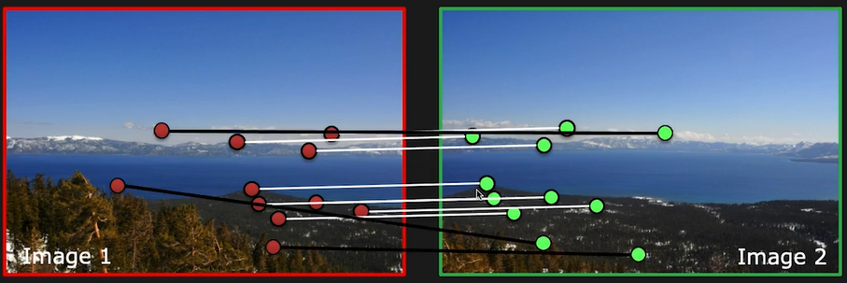
Dealing with outliers
Outliers !
We need to robustly compute transformation in the presence of wrong matches.
If number of outliers < 50%, then RANSAC to the rescue !

Slide 46

Random Sample Consensus
General RANSAC Algorithm:
Randomly choose s samples. Typically s is the minimum samples to fit a model.
Fit the model to the randomly chosen samples.
Count the number M of data points (inliers) that fit the model within a measure of error $ε$.
Repeat Steps 1-3 N times.
Choose the model that has the largest number M of inliers.
For homography:
$s=4$ points, $ε$ is acceptable alignment error in pixels.

Slide 47
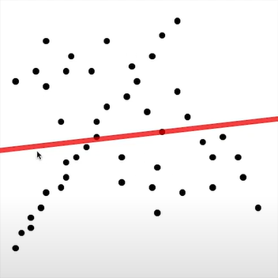
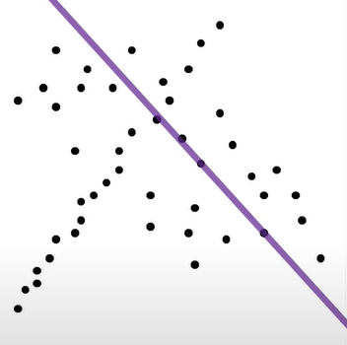
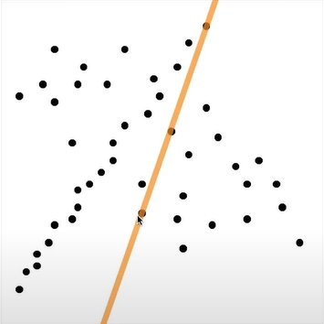
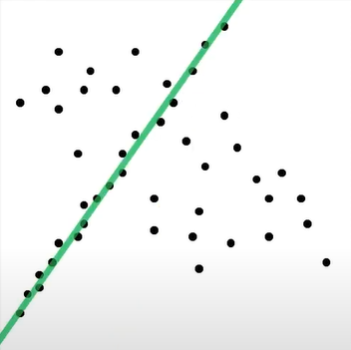
Random Sample Consensus
Inliers: 2
RANSAC Iteration 1
Inliers: 4
RANSAC Iteration 2
Inliers: 3
RANSAC Iteration i
Inliers: 20

Slide 48


Warping Images
Given a transformation T and an image $f\left(x,y\right)$, compute the transformed image $g(x,y)$
$$g\left(x,y\right)=f(T\left(x,y\right))$$

Slide 49



Forward Warping
Send each pixel $(x,y)$ in $f(x,y)$ to its corresponding location $T(x,y)$ in $g(x,y)$
$$g\left(x,y\right)=f(T\left(x,y\right))$$
What if pixel lands in between pixels ?
What if not all pixels in $g(x,y)$ are filled ?
Can result in holes !

Slide 50


Backward Warping
Send each pixel $(x,y)$ in $f(x,y)$ to its corresponding location $T¯¹(x,y)$ in $g(x,y)$
$$g\left(x,y\right)=f(T\left(x,y\right))$$
What if pixel lands in between pixels ?
Use Nearest Neighbor or Interpolate

Slide 51


Image Alignment Process

Slide 52
Image Alignment Process
Compute the bounds of Image 1 and Image 3 in inference image space.
For each pixel within bounds, compute its location in captured image.

Slide 53

Image Alignment Process

Slide 54

Blending Images
Hard seams due to vignetting, exposure differences, etc

Slide 55

Blending Images: Averaging
Seams still visible

Slide 56









Blending Images
+
=
Image $I_{1}$
Image $I_{2}$
Hard overlay
Weight $w_{1}$
Weight $w_{2}$

Slide 57











Blending Images
+
=
Image $I_{1}$
Image $I_{2}$
Blended Image $I_{blend}$
$$I_{blend}=\frac{w_{1}I_{1}+w_{2}I_{2}}{w_{1}+w_{2}}$$
Weight $w_{1}$
Weight $w_{2}$

Slide 58

Computing Weighting Functions
Pixels closer to the edge get a lower weight

Slide 59
Weight blending

Slide 60
Thanks for watching !

